Slide 1
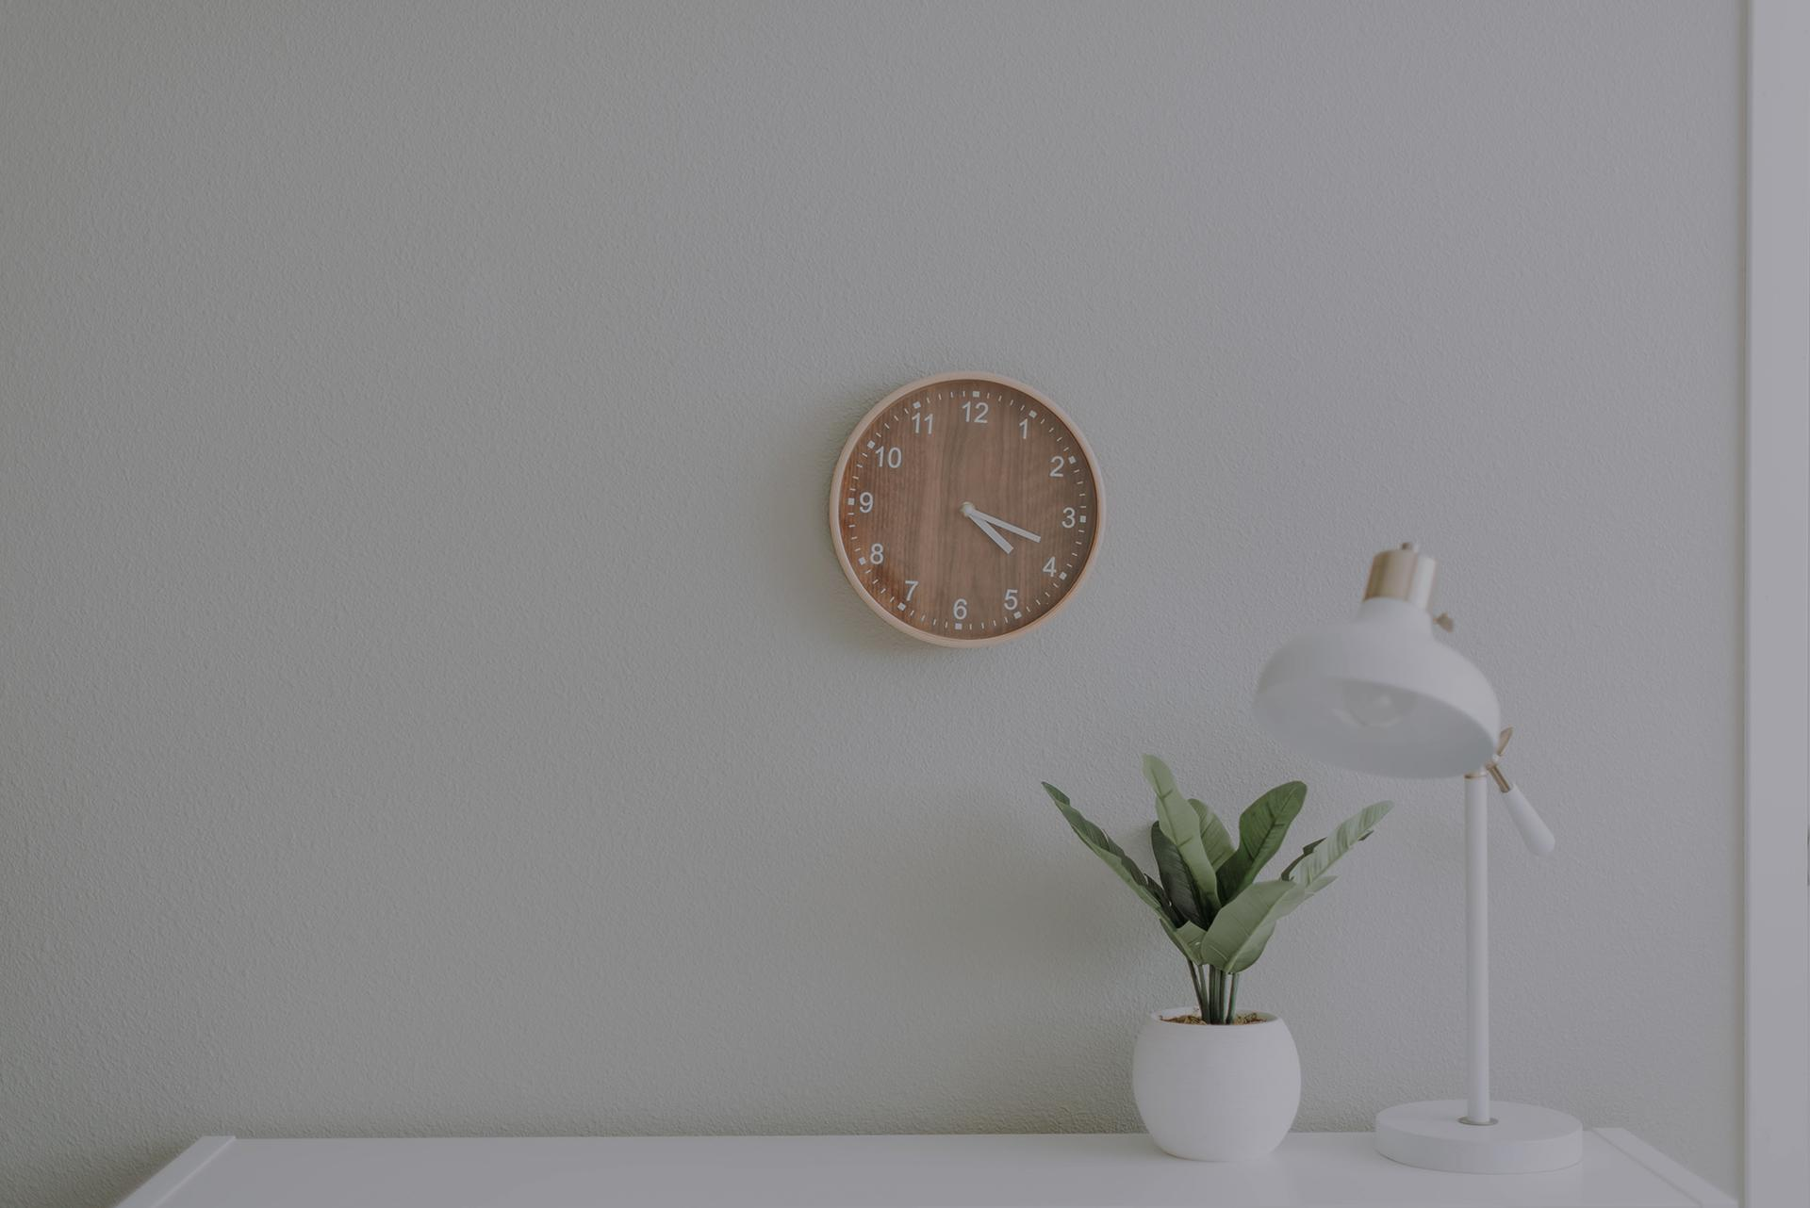
20 Habits For
Building Self-Discipline
Working From Home

Slide 2
Tip #1
Just Start
Writers’ block doesn’t just affect writers – it can affect anyone. It basically means that starting a project is always the hardest part. But don’t just stare at the blank page: just start as soon as possible and then plough on. You can always go back and fix it.

Slide 3
Tip #2
The one minute rule
If a task takes one minute or less, finish it right away. This helps you reduce your to-do list, which makes you feel significantly less stressed.

Slide 4
Tip #3
Start your day early
The more you do early on, the freer the rest of your day will be. And you’ll feel super productive!

Slide 5
Tip #4
Eat the frog
This means you should do the biggest and most unpleasant task first. It’s better behind you than in front of you!

Slide 6
Tip #5
Block out distractions
Try to get into a flow state. Invest in noise cancelling headphones to make this easier.

Slide 7
Tip #6
Schedule rewards and downtime
You can’t be focussed for 8 hours in a row, so make sure your downtime is scheduled. Try the Pomodoro technique.

Slide 8
Tip #7
Sleep!
Your sleep the night before will directly impact on your productivity today. Make sure to give this a high priority.

Slide 9
Tip #8
Exercise
Working from home can mean getting zero exercise. Make sure this isn’t the case by going out and running, or by lifting weights at home.

Slide 10
Tip #9
Get sunlight
Failure to do this can have similarly negative health and focus consequences.
.

Slide 11
Tip #10
Eat properly
Breakfast is especially important if you want to be productive. Aim for filling, complex carbs.

Slide 12
Tip #11
Dress for the job you want
Don’t work in your pyjamas! It sets the wrong tone for the day and makes you feel less productive.

Slide 13
Tip #12
Use Notion
Try this amazing app for note taking and project management.

Slide 14
Tip #13
Get an Apple Watch
Not only can an Apple Watch put your notifications on your wrist (keeping you away from your phone), it can also constantly display your todo list with Todoist!

Slide 15
Tip #14
Try study videos
These let you work alongside someone else who is being productive. Many people find this very helpful.

Slide 16
Tip #15
Sensory deprivation
Sensory deprivation means using noise cancelling headphones or large screens to block out as many distractions as possible.

Slide 17
Tip #16
Separate downtime and work time
When you finish work you should not engage with your work in any way. That means turning off notifications, or having a separate work phone.

Slide 18
Tip #17
Get social interaction
Social interaction is highly important if you want to stay sane! Try calling people at lunch.

Slide 19
Tip #18
Be inspired by what you do
This may be easier said than done, but if you are inspired by your work and you’re passionate about it, you will find it to be intrinsically motivating.

Slide 20
Tip #19
Start tomorrow’s job
Start whatever you have to do tomorrow before you clock off tonight. That prevents you from having to start a new task first thing in the morning – which is hard!

Slide 21
Tip #20
Create accountability
Tell your clients you will send them your work as you complete it. Now you HAVE to do something useful with your time!

