Slide 1
Dear Valued Customer,

Slide 2
Would You Like To Discover A Shortcut To Live a Cruelty Free Diet?

Slide 3
If so, pay close attention to this very limited, special offer…

Slide 4
You will only see this once…

Slide 5
First off, thanks so much for purchasing the guide that will teach you all the skills you need to Go Vegan.

Slide 6
If you follow the step-by-step guide, you will be heading straight to that goal.

Slide 7
But, what if you could do it even faster.

Slide 8
And what if you could ensure that you get the absolute BEST results possible and stay focused.

Slide 9
In short, making sure that this is a real success.

Slide 10
Now the good news is that you can…

Slide 11
For a limited time, you can get access to the video upgrade to the guide you just purchased at a very low price.

Slide 12
This powerful upgrade will make it easier to get started and stay committed to your ultimate goal.

Slide 13
Just to be clear, this is an EXCLUSIVE upgrade for customers only.

Slide 14
Why Do You Need To Upgrade To The Video Version Of The “Going Vegan” Guide?

Slide 15
Did you know that most people learn a lot faster when they see something being done on video other than just by reading about it?

Slide 16
That’s because most people out there are visual learners.

Slide 17
How do you normally learn the best?

Slide 18
Although the guide you just purchased gives you a step-by-step approach to Go Vegan,

Slide 19
experience tells us that it requires learners to pay very close attention to the details to get the best results possible.

Slide 20
If you miss any of the most important details or do things the wrong way,

Slide 21
you may miss out on the fullest benefits offered inside the guide.

Slide 22
For that very reason, I’ve put together a video version to make it easier to get positive results quickly.

Slide 23
The Video Version Of The Guide You Just Purchased Will Help You...
Avoid missing any important key details that you might miss by only reading the guide.
Stay focused and accountable, and follow through and make sure you get ongoing results.
Ensure that the work you put in now keeps on giving you benefits long into the future.

Slide 24
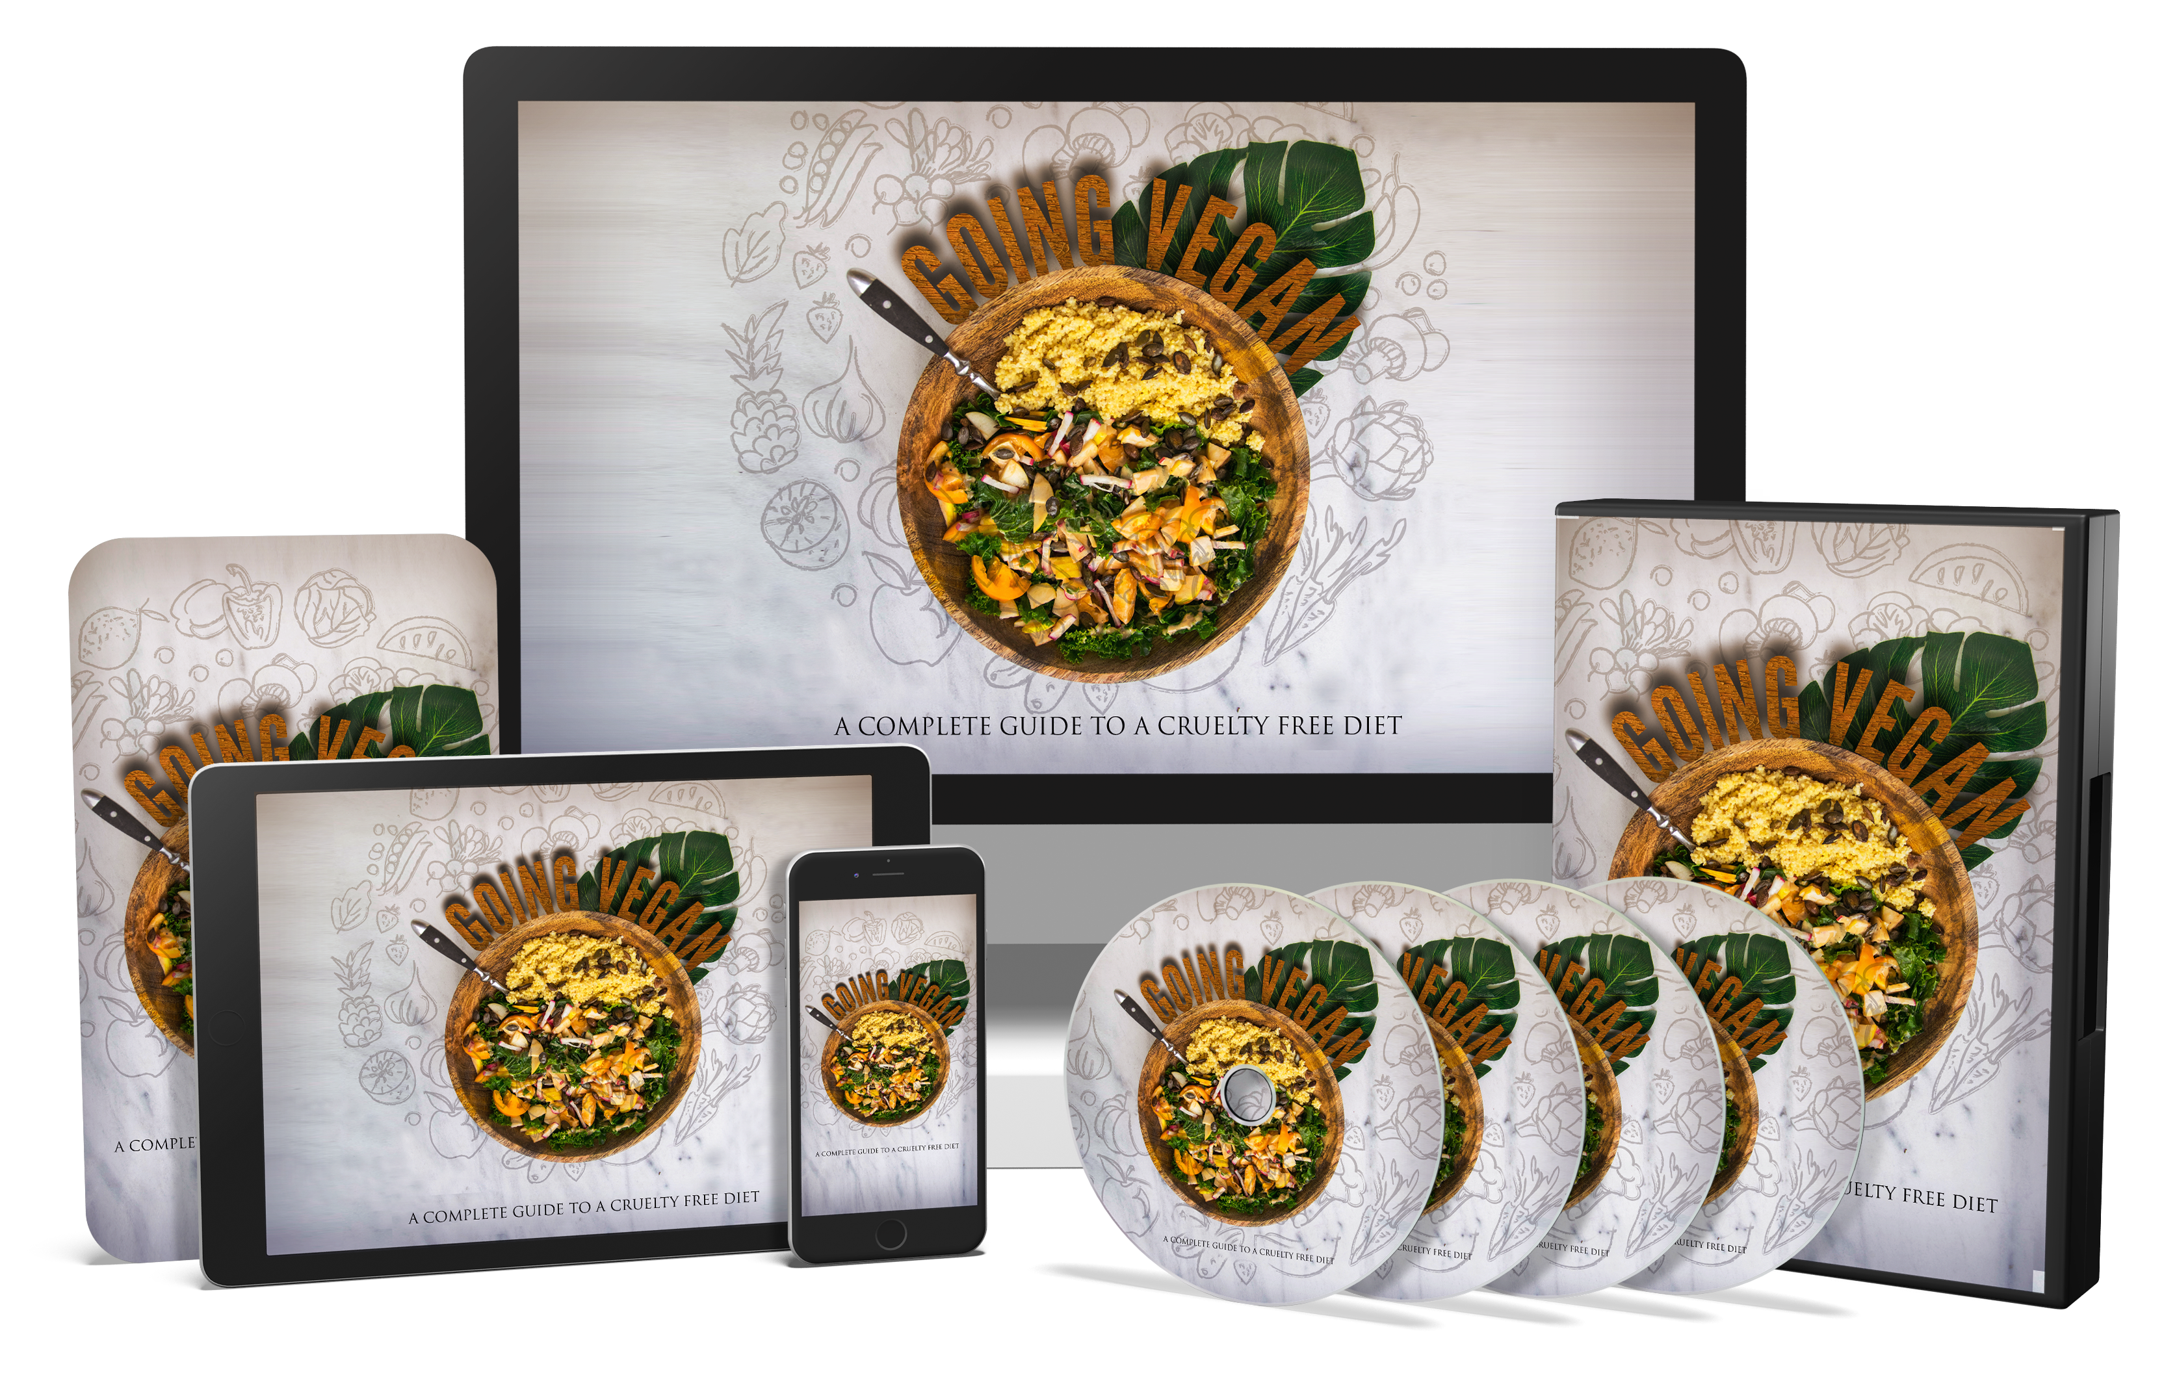
Introducing…

Slide 25
If the answer is “YES,” click the link below…

Slide 26
Of course, you’re probably wondering how much this is going to cost, right?

Slide 27
First off, ‘cost’ is the wrong word… This upgrade is an investment that will pay for itself many times over.

Slide 28
This is the next best thing to having an expert on the subject, right beside you, showing you how it’s done.

Slide 29
Of course, hiring an expert would easily set you back hundreds of dollars.

Slide 30
Luckily, you’re not going to have to invest anywhere near that today to get the next best thing.

Slide 31
Not only will you avoid many of the most common mistakes that people make when going vegan,

Slide 32
you’ll notice immediate positive results in your achievements…

Slide 33
And it’s about to get even better…

Slide 34
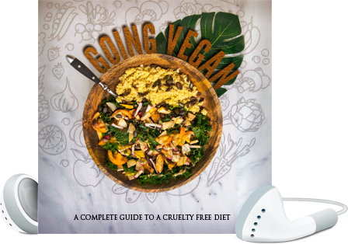
When You Upgrade Today, You’ll Also Get This Exclusive Fast Action Bonus…
Fast Action Bonus
High-Quality MP3s Of The Entire Video Version Of The Training
(Valued at $27)

Slide 35
And here’s what’s really great about this...

Slide 36
You Don’t Have To Decide Anything Today...

Slide 37
You get a full 30 days to go through the video training and decide if this is really for you.

Slide 38
If for any reason, or no reason at all, you’re not 100% satisfied with everything you get inside, simply let me know…

Slide 39
…and I’ll refund every penny of your tiny investment.

Slide 40
No questions asked!

Slide 41
Here’s How To Get Instant Access To The Video Version Today...

Slide 42
Simply click the link below, enter your information, and you’ll get INSTANT ACCESS…

Slide 43
But, Please Don’t Wait, you MUST grab this RIGHT NOW!

Slide 44
In fact, if you close this page, you may never have the opportunity to upgrade…

Slide 45
Are you ready To Make Things Happen a lot faster?

Slide 46
If you prefer to learn by being shown how to do something, and you want to get results quickly… this is for you…

Slide 47
If you’re REALLY serious about living a Cruelty Free Diet… this is for you...

Slide 48
And, if you’re one of those people that’s a visual learner, you NEED THIS!

Slide 49
Here’s to becoming the most productive YOU that you can be!

Slide 50
Remember, if you close this page, you may never see this again at such a low investment.

Slide 51
There’s no risk… Try this out for 30 days and then decide if it’s for you.

